Slide 1
Distribution of ULF wave power in magnetic latitude based on THEMIS and Arase measurements
Laboratory for Atmospheric & Space Physics CU, Boulder, Colorado
Space Research Laboratory, Xanthi, Greece
Theodore E. Sarris, Xinlin Li, Hong Zhao, Kostis Papadakis, Wenlong Liu, Weichao Tu, Vassilis Angelopoulos, Karl-Heinz Glassmeier, Yoshizumi Miyoshi, Ayako Matsuoka, Iku Shinohara, Shun Imajo
THEMIS/ARTEMIS SWT Meeting Winter 2022

Slide 2
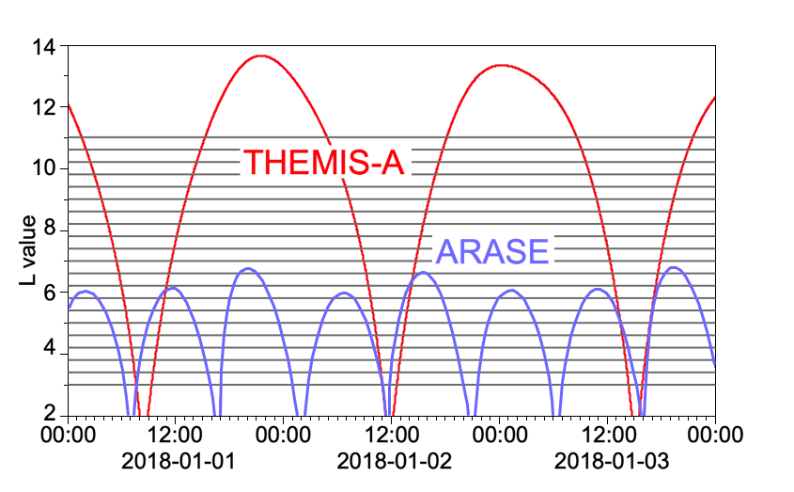
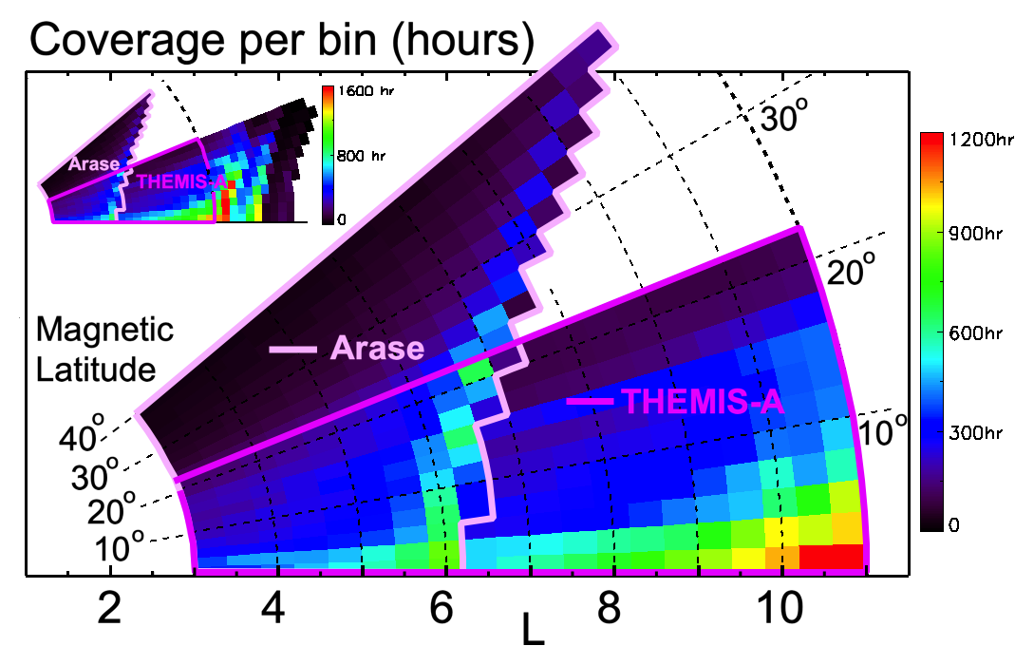
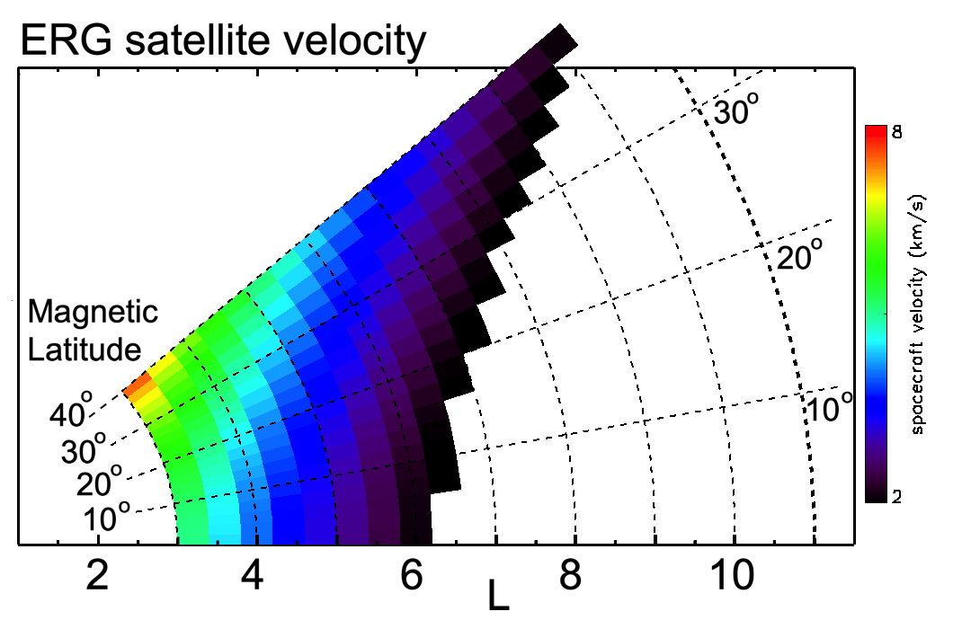
Statistical analysis
Coverage in L – sample 3 days
Total time per L & magnetic latitude
Arase spacecraft velocity
-- 14.5 years of THEMIS-A data
-- 3.5 years of Arase data
--B-field power, Field-Aligned Coords
-- Pc4 and Pc5 range of frequencies
i ~31º
i ~11º
L
L
L

Slide 3
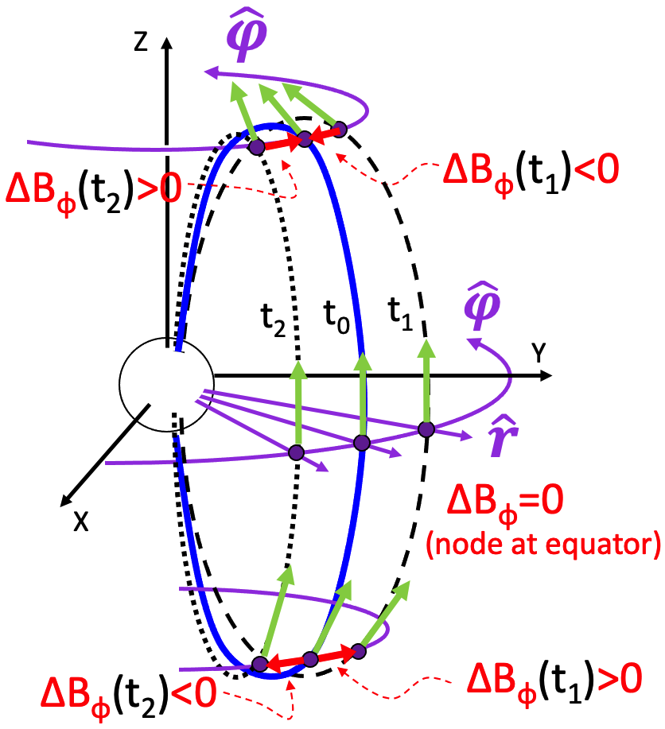
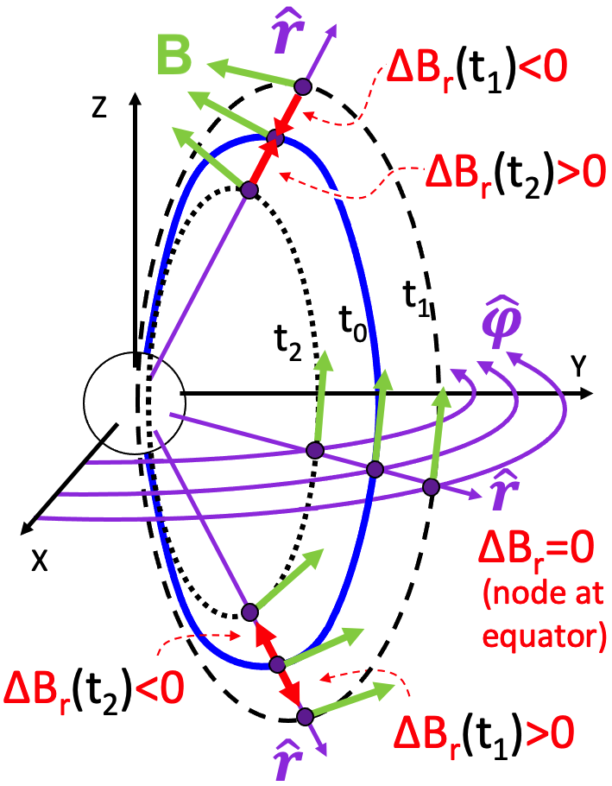
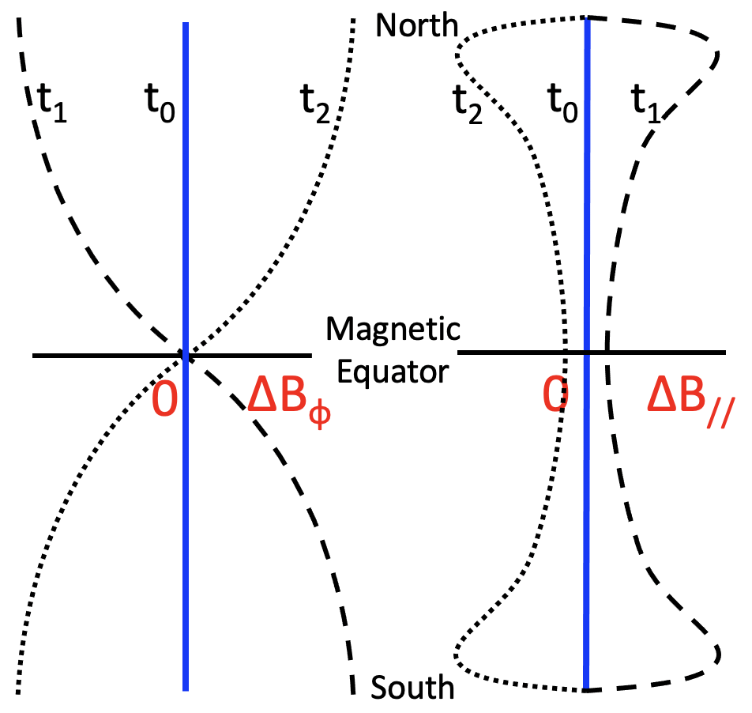
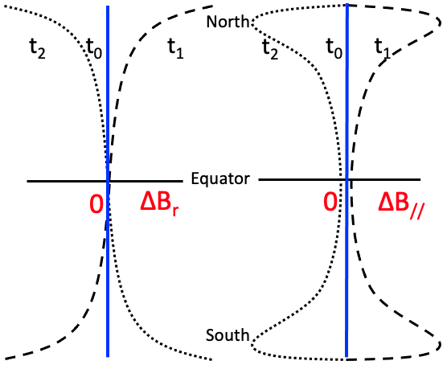
Comparison with theory
TOROIDAL PULSATIONS – fundamental mode
POLOIDAL PULSATIONS – fundamental mode
Amplitudes from models by
Wang et al. (2018), Li Li et al. (2021)
L
L
L

Slide 4
Implications
Ultra-low frequency (ULF) waves are known to radially diffuse hundreds-keV to few-MeV electrons in the magnetosphere
Radial diffusion is presently described by analytic expressions for radial diffusion coefficients that in most expressions are derived for equatorially mirroring electrons.
Analytic expressions estimate the radial diffusion rates based on measurements of the power of ULF waves that are either made from spacecraft close to the equatorial plane or from the ground.
The statistical analysis based on THEMIS and Arase measurements shows that ULF wave power of the magnetic field increases away from the magnetic equator.
This result could have significant implications for the radial diffusion rates as currently estimated, and points to the need for pitch-angle-dependent diffusion coefficients.
Sarris et al., 2022, in preparation
THEMIS/ARTEMIS SWT Meeting Winter 2022

